Slide 1
XML JDOM Processing
Comp4711
#5b – Feb 3/09

Slide 2
XML JDOM Processing
What is JDOM?
JDOM examples
JDOM API

Slide 3
1. What Is JDOM?
Java-only wrapper for DOM
Concrete classes instead of interfaces
Uses the Collections framework
  Instead of NodeLists (DOM)‏
Not based on SAX or DOM
  But can work with either
Namespace aware, validating (DTD for now)‏

Slide 4
How It Works
Can build a document object model based on:
  SAX parser input
  DOM parser input
Can output its contents to:
  a DOM
  a content handler for SAX
  a stream of XML data

Slide 5
Installation
Download the latest binary version of JDOM from www.jdom.org (current latest is 1.1)‏
Grab the jdom.jar file and put it into your classpath.
  This could be a lib or WEB-INF/lib fodler inside your NB project
  This could be the $JAVA_HOME/jre/lib/ext folder in a stand-alone environment

Slide 6
JDOM Classes
Class name
Description
Text
Allows for manipulation of textual data
ProcessingInstruction
Creates and manipulates processing instructions
EntityRef
Defines an entity reference
Element
Creates and manipulates elements of an XML document
Document
Allows representation of an XML document
DocType
Creates an XML docType object
Comment
Creates and manipulates XML comments
CDATA
Creates and manipulates CDATA sections of an XML document
Attribute
Creates and manipulates element attributes

Slide 7

2... Creating root element
import org.jdom.*;
import org.jdom.output.*;
public class CreateRoot {
public static void main (String[] args) throws Exception {
Element root = new Element ("todo");
Document doc = new Document(root);
XMLOutputter op = new XMLOutputter();
op.output(doc,System.out);
}
}

Slide 8

Add content to root element
import org.jdom.*;
import org.jdom.output.*;
public class AddContent {
public static void main (String[] args) throws Exception {
Element root = new Element ("todo");
root.addContent("Backup:");
root.addContent("Sales Data");
Document doc = new Document(root);
XMLOutputter op = new XMLOutputter();
op.output(doc,System.out);
}
}
Place textual data within an element by calling the addContent() method.
Can append more data by calling same method.
You can use setText() method to replace data added with addContent() method

Slide 9

Creating child elements
import org.jdom.*;
import org.jdom.output.*;
public class CreateChildElements {
public static void main (String[] args) throws Exception {
Element task = new Element ("task");
task.addContent("Backup sales data");
Element status = new Element ("status");
status.addContent("Open");
Element root = new Element ("root");
root.addContent(task);
root.addContent(status);
Document doc = new Document(root);
XMLOutputter op = new XMLOutputter();
op.output(doc,System.out);
}
}
Assign elements to other elements in same manner as with textual data using Element’s addContent() method
Indentation can be specified when creating XMLOutputter – first argument is characters for indent, and second argument is true

Slide 10
Reading XML document with xBuilder example
import org.jdom.*;
import org.jdom.output.*;
import org.jdom.input.*;
public class UsingDOMBuilder {
public static void main (String[] args) throws Exception {
SAXBuilder jdomObj = new SAXBuilder();
java.io.File file = new java.io.File("../courses.xml");
org.jdom.Document jdomDoc = jdomObj.build( file );
XMLOutputter op = new XMLOutputter();
op.output(jdomDoc,System.out);
}
}

Slide 11
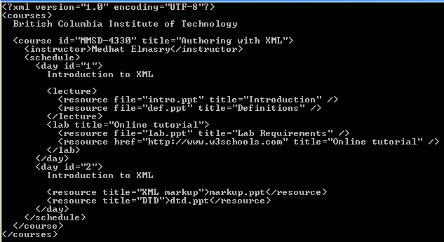

Slide 12
Extract Element Text
import org.jdom.*;
import org.jdom.output.*;
import org.jdom.input.SAXBuilder;
public class ReadText {
public static void main (String[] args) throws Exception {
SAXBuilder saxobj = new SAXBuilder();
Document doc = saxobj.build("../courses.xml");
Element element = doc.getRootElement();
String todoText = element.getTextTrim();
System.out.print ("Element <" + element.getName());
System.out.println("> contains: " + todoText);
}
}

Slide 13
Insert a comment
import org.jdom.*;
import org.jdom.output.*;
import org.jdom.input.SAXBuilder;
public class InsertComment {
public static void main (String[] args) throws Exception {
SAXBuilder saxobj = new SAXBuilder();
Document doc = saxobj.build("../courses.xml");
Element root = doc.getRootElement();
root.addContent(new Comment("Updated by Medhat"));
XMLOutputter op = new XMLOutputter();
op.output(doc,System.out);
}
}

Slide 14
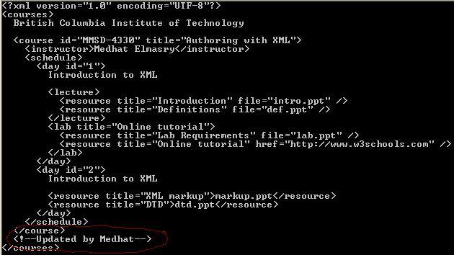

Slide 15
Determine element type
Strategy
Place elements in a java.util.List
Iterate through the contents of the List extracting each element as an object
Analyze object to determine what type of object it is
  Use instanceof operator

Slide 16
import org.jdom.*;
import org.jdom.input.SAXBuilder;
import java.util.*;
public class DetermineNodeType {
public static void main (String[] args) throws Exception {
SAXBuilder saxobj = new SAXBuilder();
Document doc = saxobj.build("../courses.xml");
List contents = doc.getRootElement().getContent();
for (Iterator iter=contents.iterator(); iter.hasNext(); ) {
Object obj = iter.next();
if (obj instanceof Element) {
System.out.println("Element found: " + obj);
} else if (obj instanceof Text) {
System.out.println("Text content found: " + obj);
} else if (obj instanceof EntityRef) {
System.out.println("Entity Reference found: " + obj);
} else if (obj instanceof ProcessingInstruction) {
System.out.println("Processing Instruction found: " + obj);
} else if (obj instanceof Comment) {
System.out.println("Comment found: " + obj);
} else if (obj instanceof CDATA) {
System.out.println("CDATA section found: " + obj);
}
}
}
}

Slide 17

Determine element type - example

Slide 18
Working with Attributes
Attribute objects:
  Represent name and value pairs of an attribute
  Contructor: new Attribute(strName, strValue)‏
  clone() method creates duplicate Attribute objects
  setValue(String) assigns a new value to an Attribute object
Element methods
  setAttribute(String,String) assigns name and value pairs to an element
  removeAttribute(String) removes an attribute

Slide 19
Working with attributes - example
import org.jdom.*;
import org.jdom.output.*;
import org.jdom.input.SAXBuilder;
public class ACDAttributes {
public static void main (String[] args) throws Exception {
SAXBuilder saxobj = new SAXBuilder();
Document doc = saxobj.build("../courses.xml");
Element root = doc.getRootElement();
// get first course element
Element course = root.getChild("course");
// create a new attribute 'term' and add to 'course'
course.setAttribute( new Attribute("term", "b") );
// change value of 'title' attribute
course.setAttribute( new Attribute("title", "Working with XML") );
// remove attribute 'id'
course.removeAttribute( "id" );
XMLOutputter op = new XMLOutputter();
op.output(doc,System.out);
}
}

Slide 20
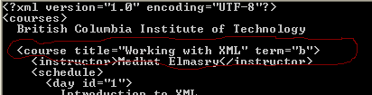

Slide 21
Save an XML document
With JDOM, you can use standard Java procedures to save information to a file
You can use the FileWriter class of the java.io package to create files from within Java code
Pass FileWriter object + JDOM document to XMLOutputter object
Remember to close your FileWriter object

Slide 22
Saving XML documents - example
import org.jdom.*;
import org.jdom.output.*;
import org.jdom.input.SAXBuilder;
import java.io.*;
public class SaveDoc {
public static void main (String[] args) throws Exception {
SAXBuilder saxobj = new SAXBuilder();
Document doc = saxobj.build("../courses.xml");
Element root = doc.getRootElement();
// get first course element
Element course = root.getChild("course");
// create a new attribute 'term' and add to 'course'
course.setAttribute( new Attribute("term", "b") );
// change value of 'title' attribute
course.setAttribute( new Attribute("title", "Working with XML") );
// remove attribute 'id'
course.removeAttribute( "id" );
FileWriter fw = new FileWriter("../updated_courses.xml");
XMLOutputter op = new XMLOutputter();
op.output(doc,System.out);
op.output(doc,fw);
fw.close();
}
}
Output is being sent to both file and display simultaneously

Slide 23
JDOM API
Note to self: JDOM API

